Slide 1
Employee Performance Analysis Using Excel
PRESENTED BY: NITHIYA SHREE M
REGISTER NO.: 312204596
DEPARTMENT: COMMERCE
COLLEGE: K.C.S KASI NADAR COLLEGE OF ARTS AND SCIENCE

Slide 2
PROJECT TITLE
Employee Performance Analysis Using Excel

Slide 3
AGENDA
1.Problem Statement
2. Project Overview
3.End Users
4.Our Solution and Proposition
5. Dataset Description
6. Modelling Approach
7. Results and Discussion
8.Conclusion

Slide 4
PROBLEM STATEMENT
Analyze the performance distribution of employees based on their performance scores. The goal is to identify the proportion of employees in each performance category—"Needs Improvement," "Fully Meets," and "Exceeds." The analysis should help determine if there are any performance trends or areas needing attention within the organization. Specifically, the objective is to understand the extent to which employees fall into each performance category and to assess if targeted interventions or support are necessary for those categorized as "Needs Improvement."
Overrepresentation of Laborers
Underrepresentation of Critical Roles
Possible Gaps in Management

Slide 5
PROJECT OVERVIEW
[ANALYZING EMPLOYEE PERFORMANCE DISTRIBUTION]
You are analyzing employee performance scores based on three categories: "Exceeds," "Fully Meets," and "Needs Improvement." The data is organized into a pivot table showing the total performance scores of employees across these categories.
Objective:
Summarize the Data: Identify the total scores for each category and the overall total.
Evaluate Performance: Determine how many employees fall into each performance category and assess the total scores contributed by each category.
Identify Discrepancies: Check for any inconsistencies or discrepancies in the totals and ensure that the sum of scores across categories matches the overall total provided.

Slide 6
WHO ARE THE END USERS?
Department Managers (Sales & Production)
Senior Leadership/Executives
Employees
Finance/Compensation Teams

Slide 7
OUR SOLUTION AND ITS VALUE PROPOSITION
Filtering - Remove missing values.
Conditional Formatting - Blanks, Background Color Shading, Data Bars, Values.
Data Filtering and Sorting - Identify specific employee groups, such as those with low or high performance ratings
Pivot table - Summary of employee performance under their current rating .
Graphs - FINAL REPORT.

Slide 8
DATASET DESCRIPTION
EMPLOYEE ID: Unique identifier for each employee in the organization.
FIRST NAME: The first name of the employee.
PERFORMANCE SCORE: A score indicating the employee's performance level (e.g., Excellent, Satisfactory, Needs Improvement).

Slide 9
MODELLING
DATA SET: Kaggle, Employee dataset.
FEATURE SELECTION: Slicer, Conditional Formatting, Designing.
DATA CLEANING: Missing values, Irrelevant data, Correct Errors, Remove Unnecessary Columns and Rows.
PIVOT TABLE: Employee ID, First Name, Performance Score.
CHART: Report of Employee Performance based on their Current Ratings is resented as Column Chart.

Slide 10

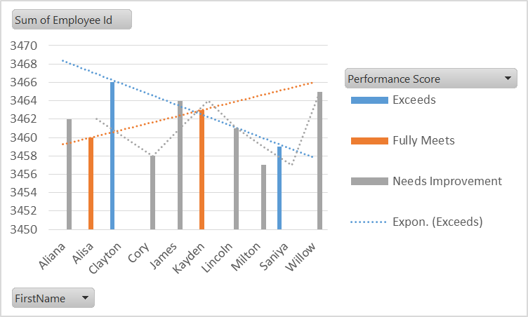

RESULTS

Slide 11

CONCLUSION
From the analysis of the performance data, the distribution of employee performance scores is as follows:
Needs Improvement: 6 employees
Fully Meets: 2 employees
Exceeds: 2 employees
This indicates that a significant majority (60%) of employees fall into the "Needs Improvement" category, while only 20% are classified as "Fully Meets" and another 20% as "Exceeds." This distribution suggests that there may be widespread performance issues within the team or organization, with the majority of employees not meeting expectations.
By addressing the needs of employees who are struggling and recognizing those who excel, the organization can improve overall performance and productivity.

Slide 12
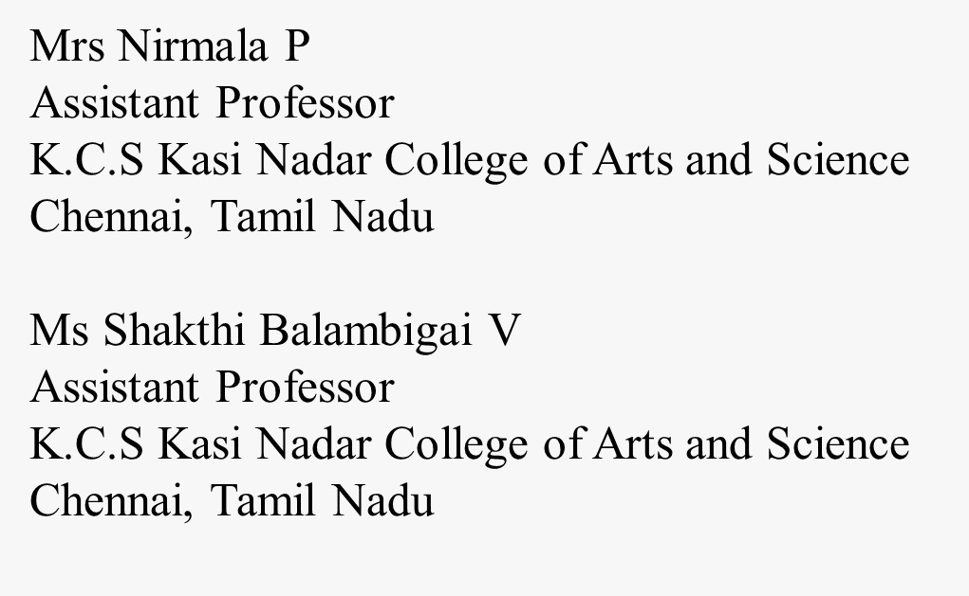
REFERENCE

